Slide 1
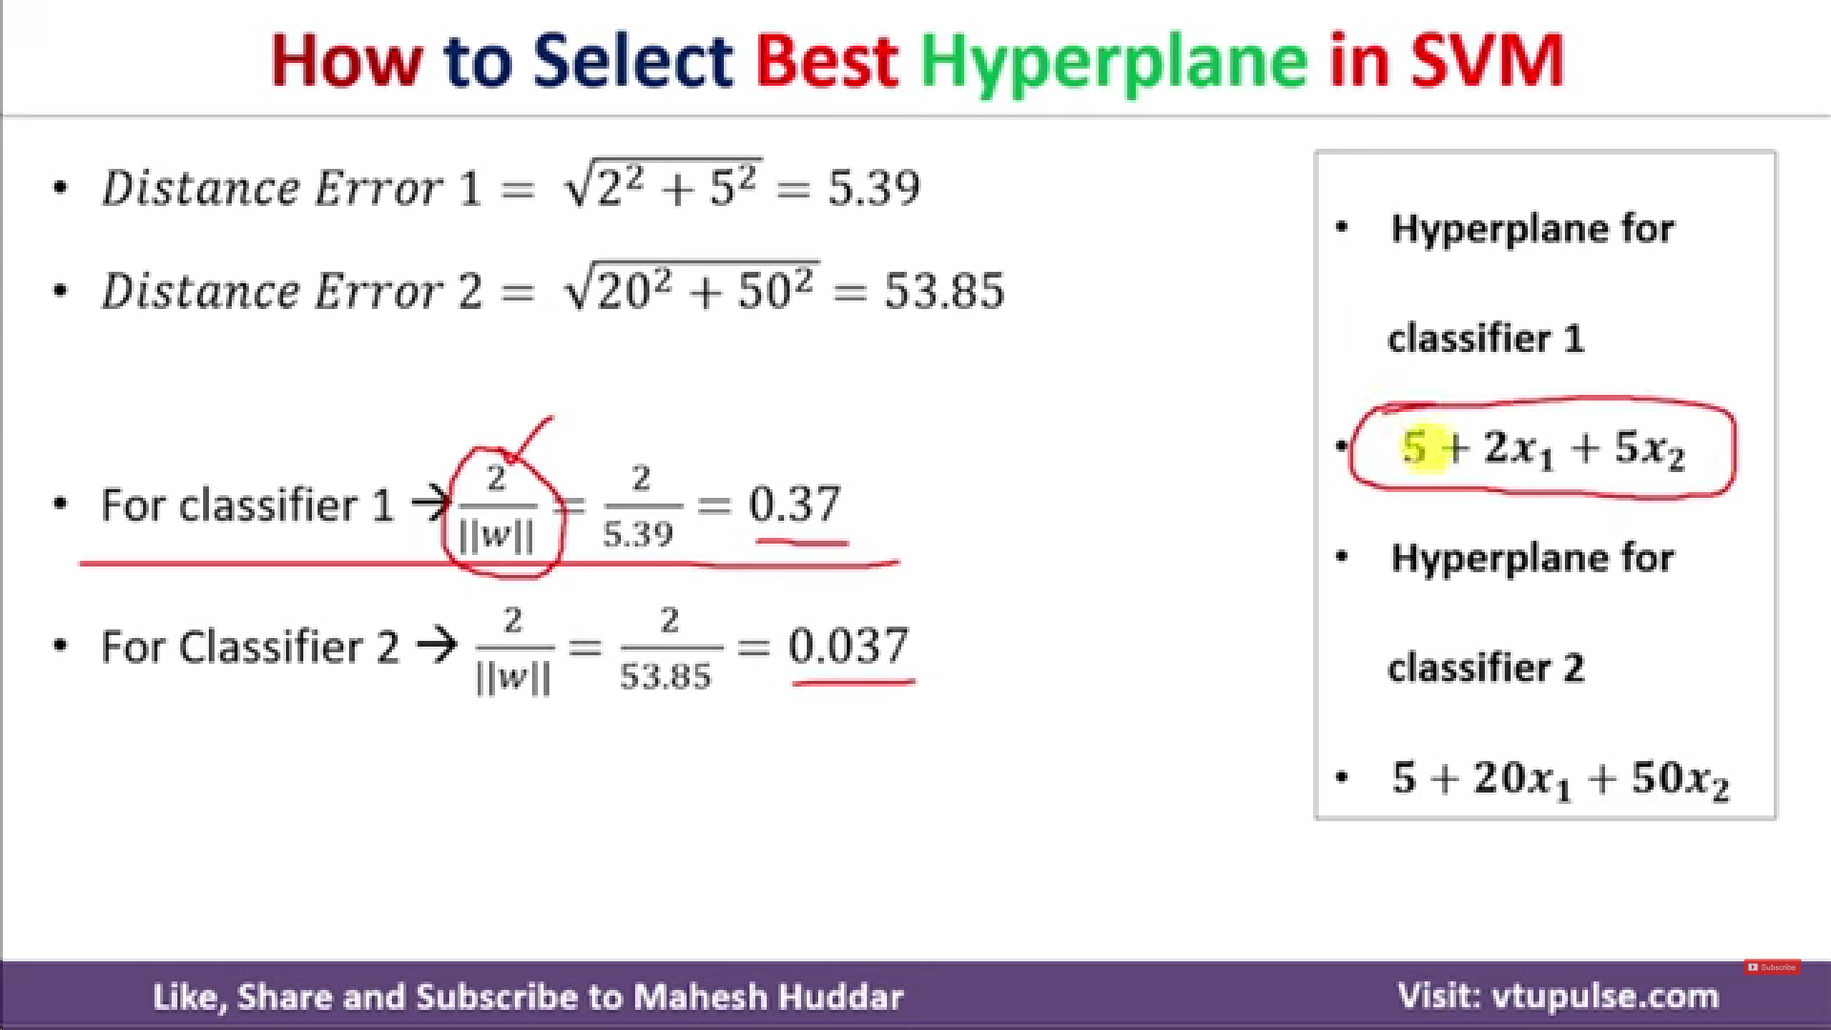
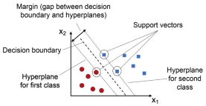




Ignore bias = 5

Slide 2
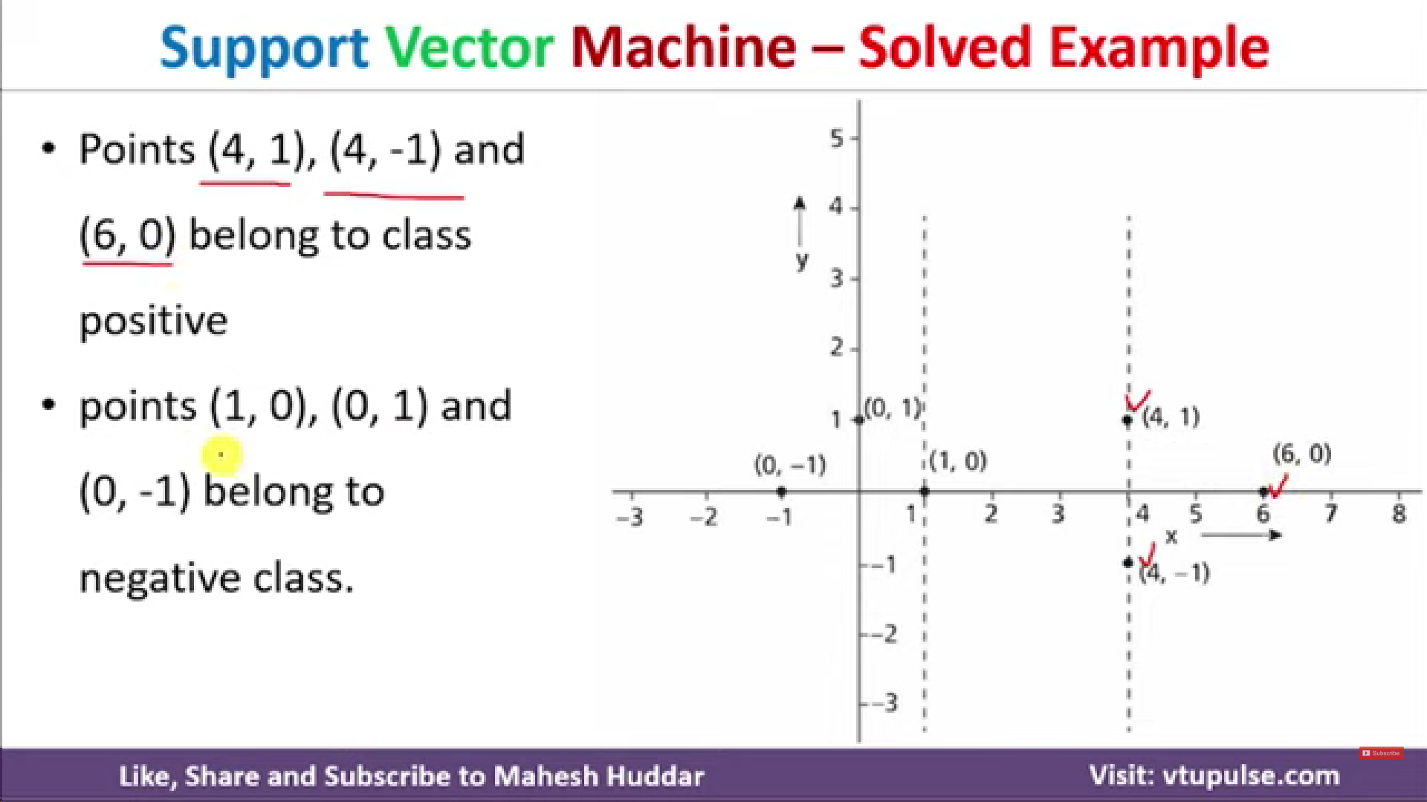

Slide 3
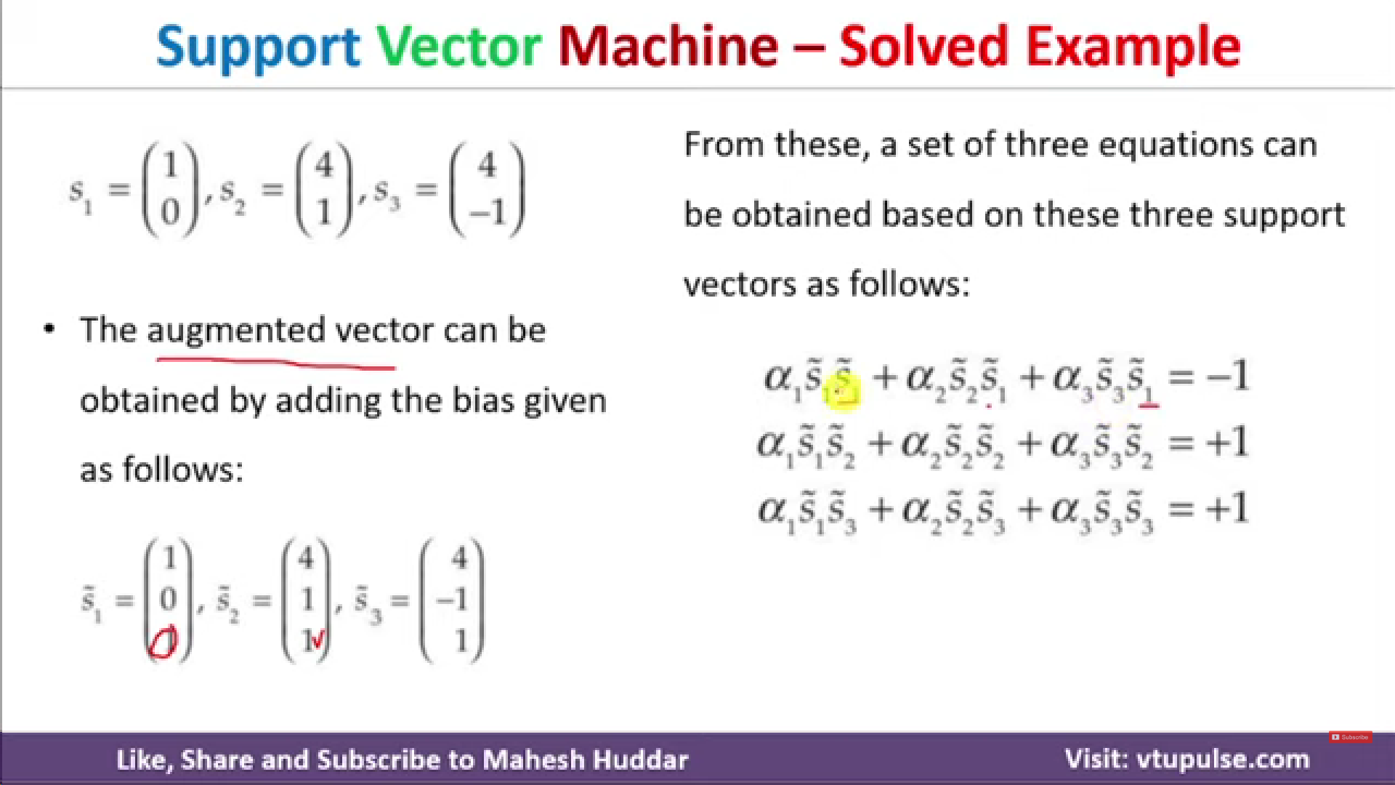


Slide 4
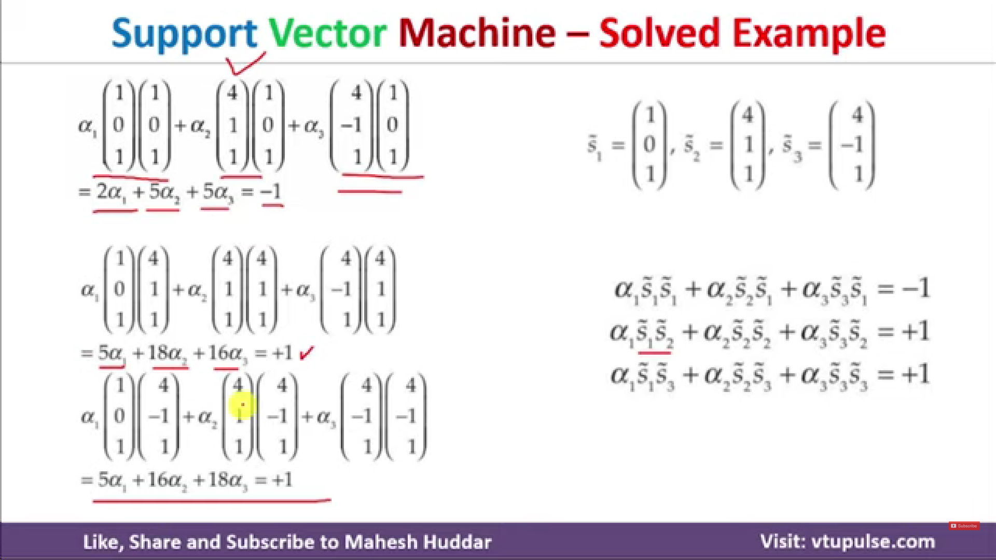

Slide 5
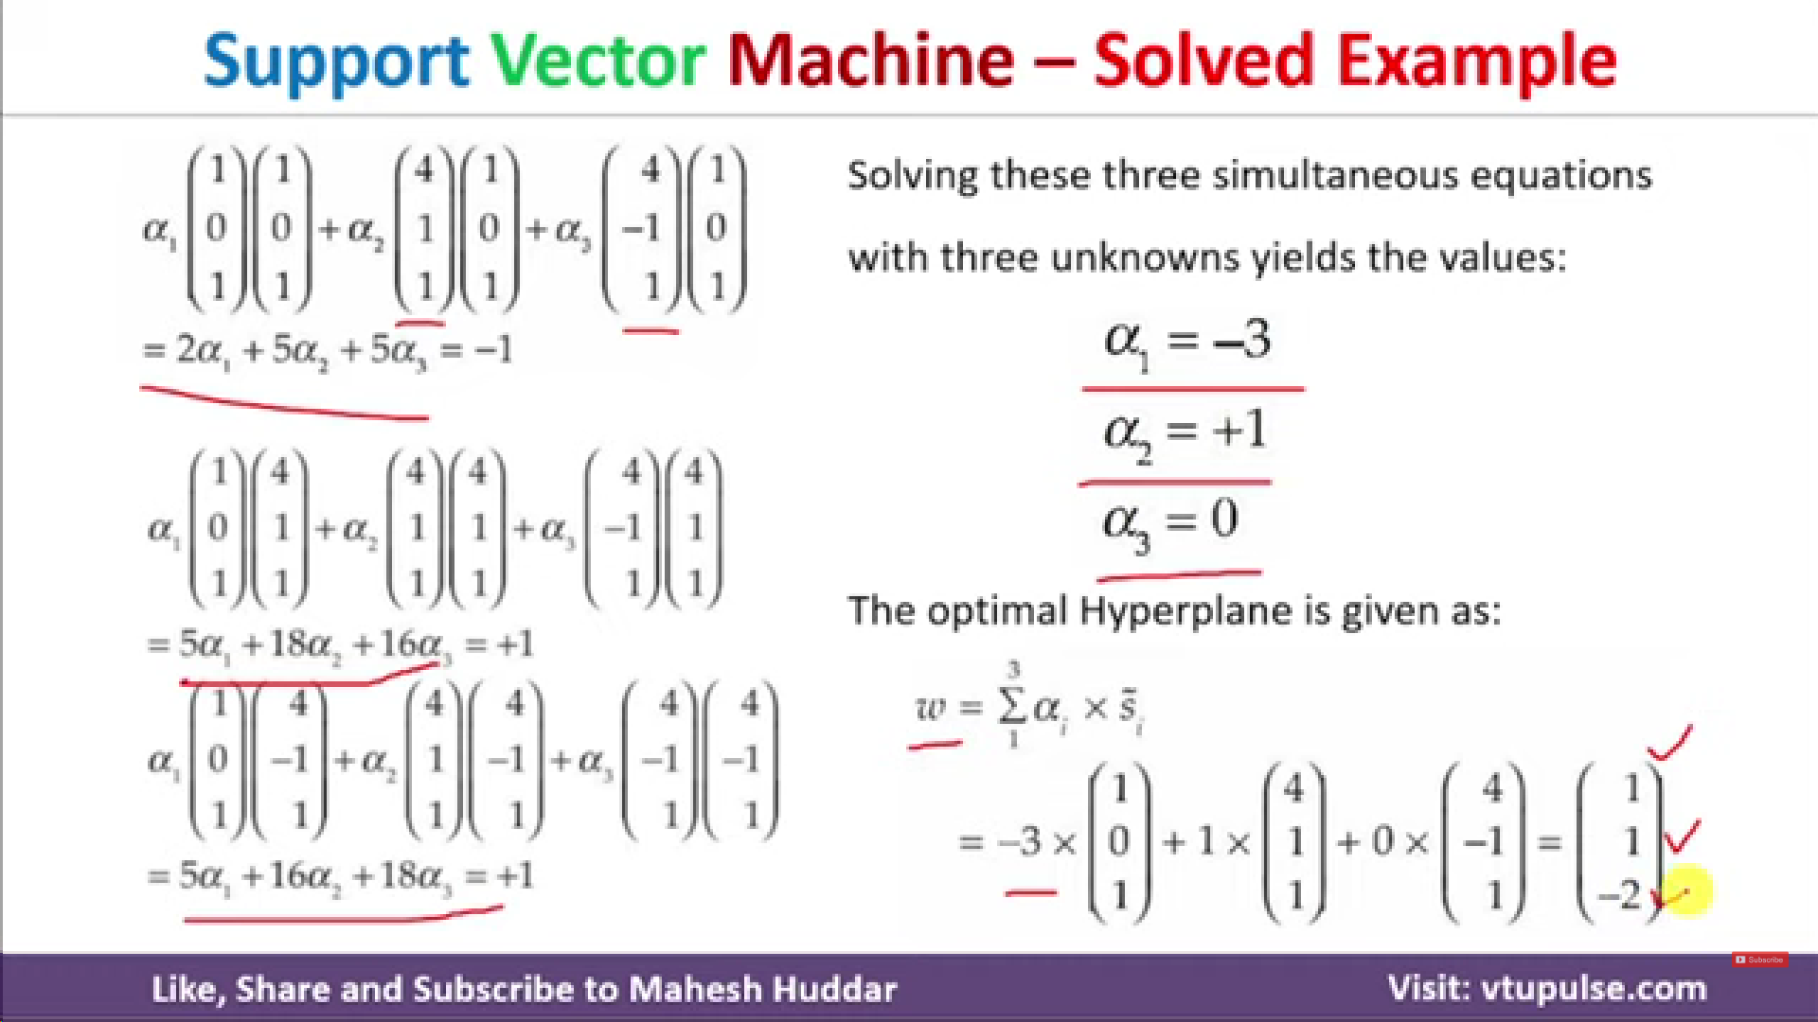



Slide 6
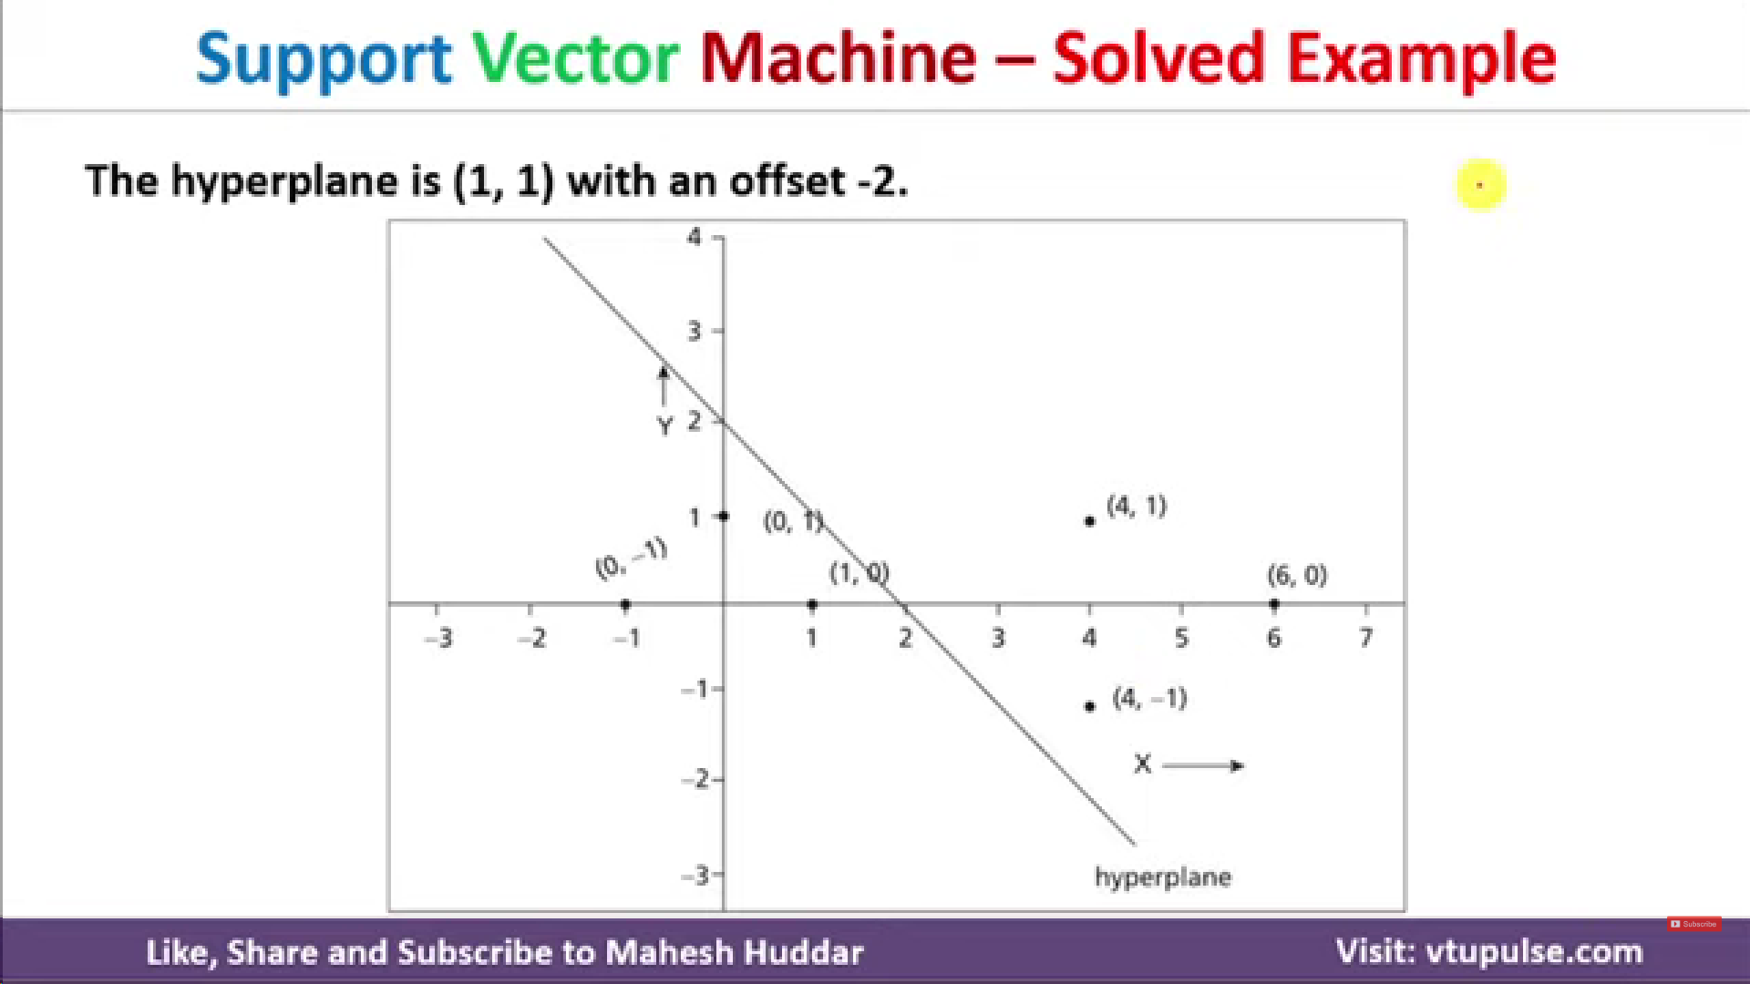

Slide 7
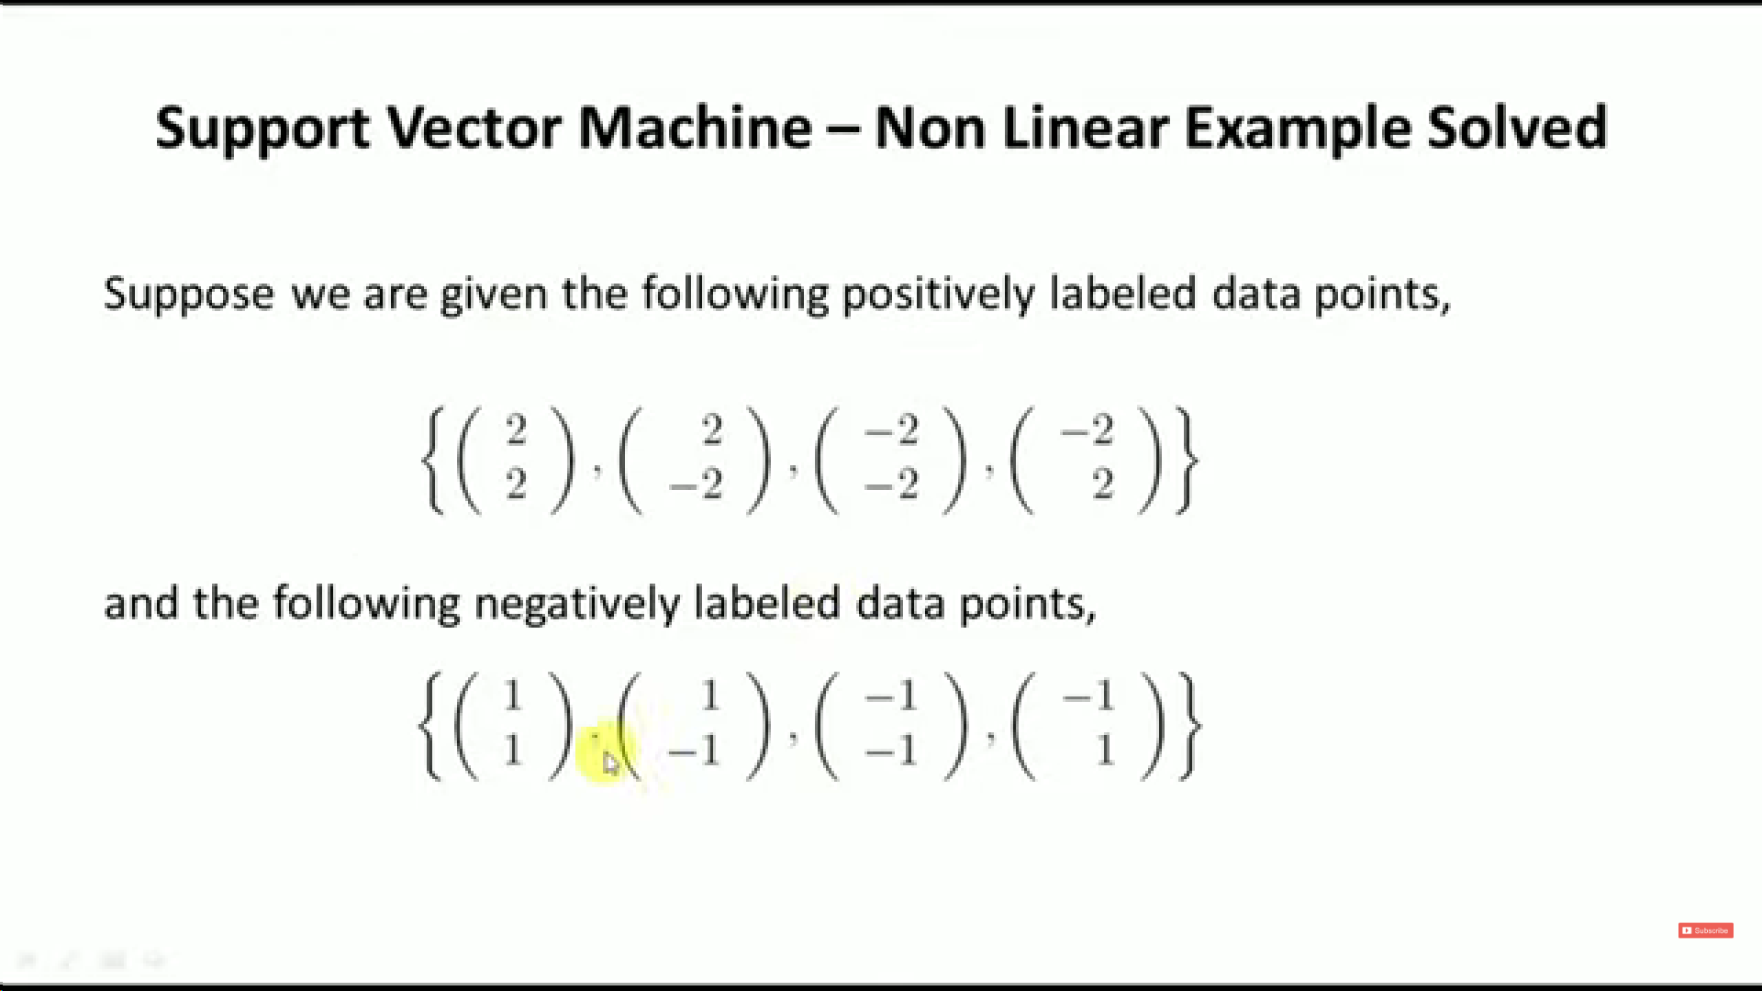

Slide 8
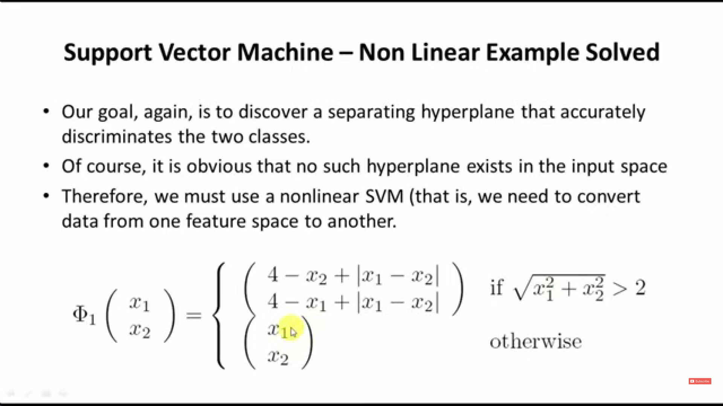

Slide 9
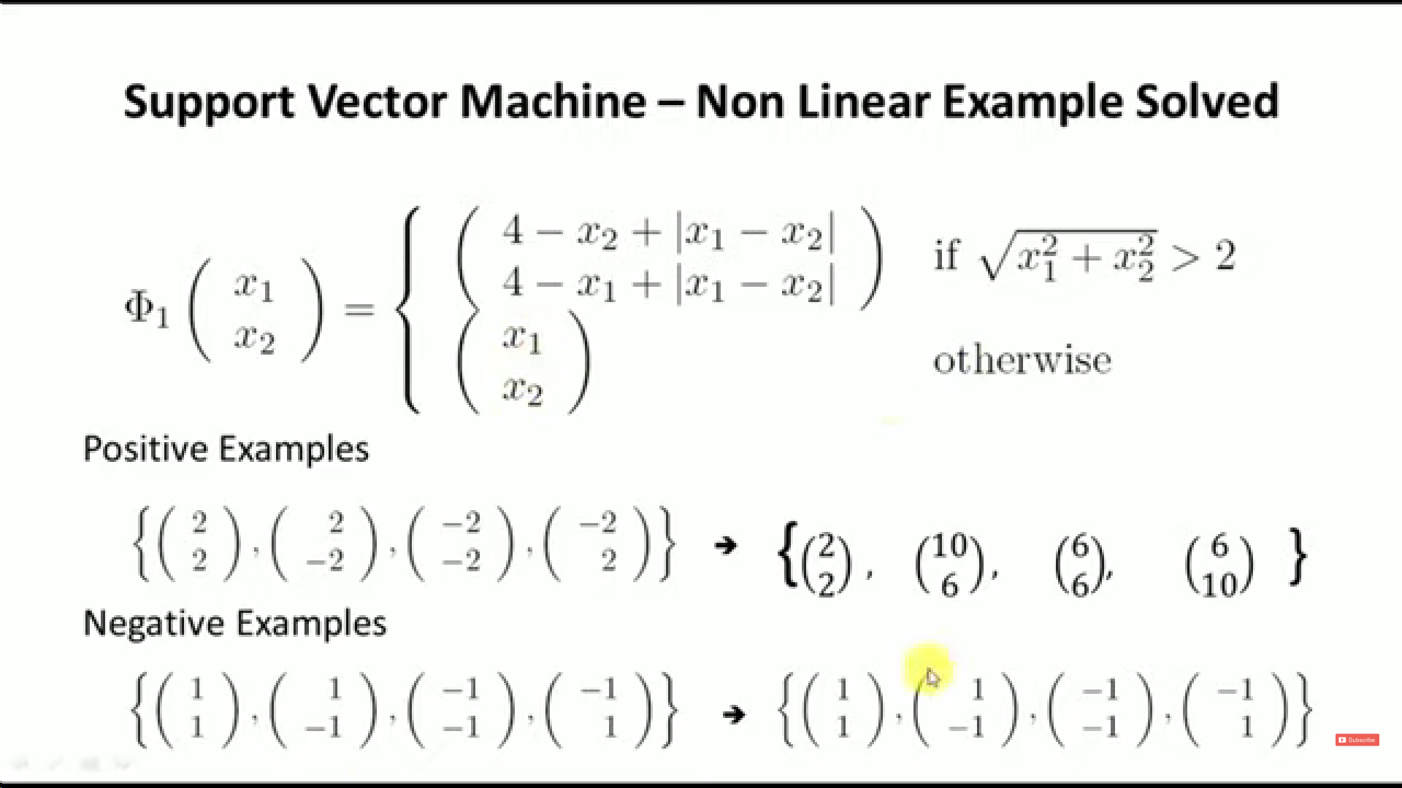

Slide 10
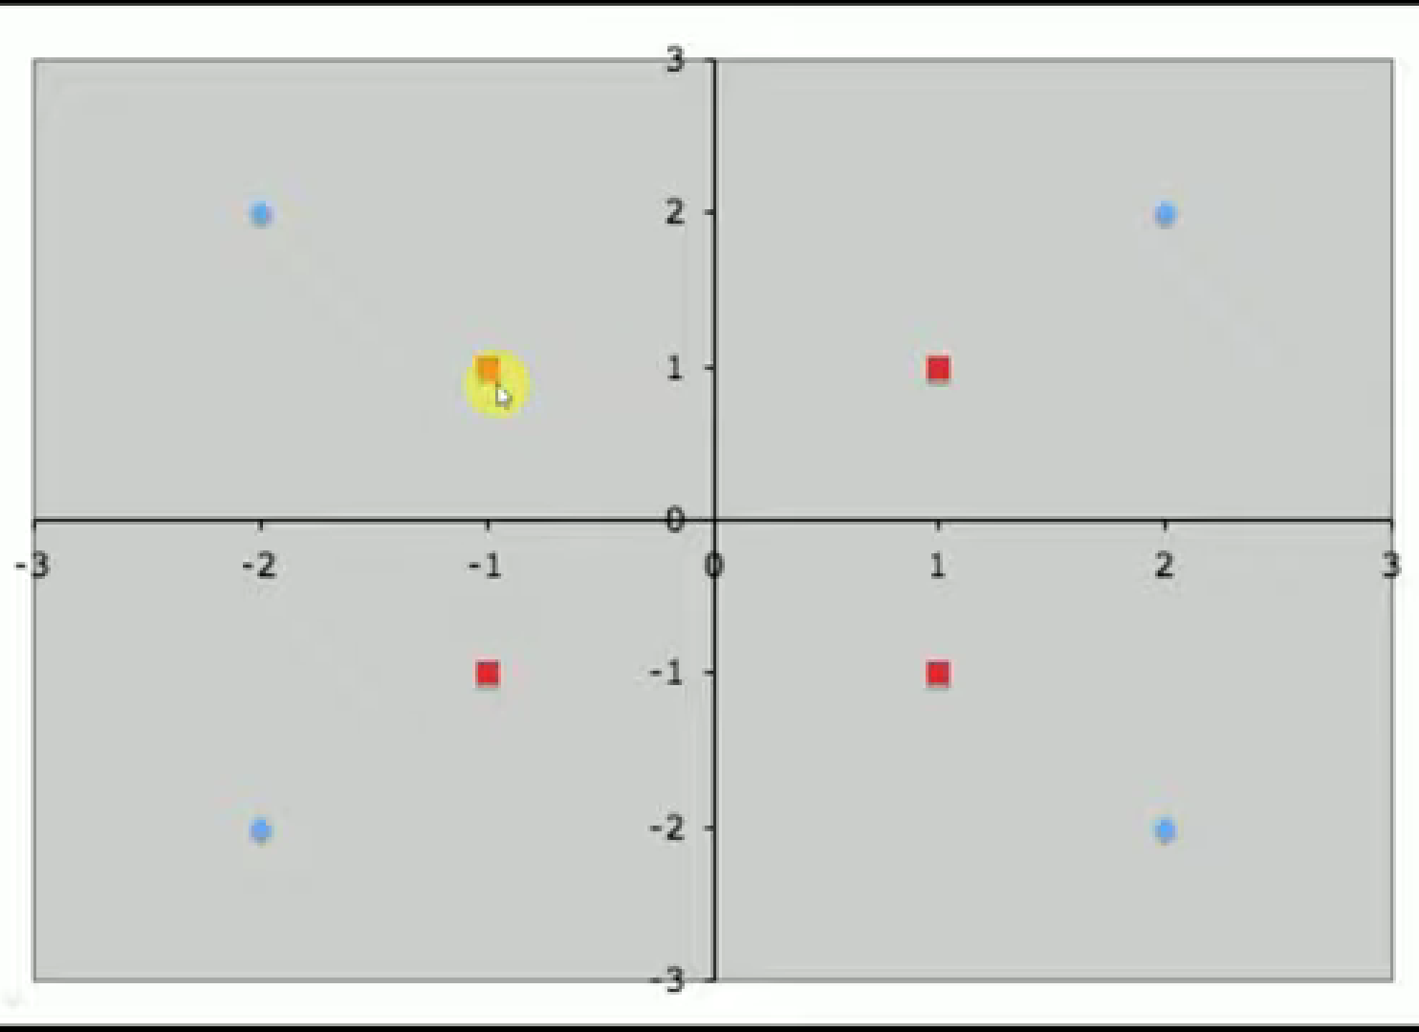
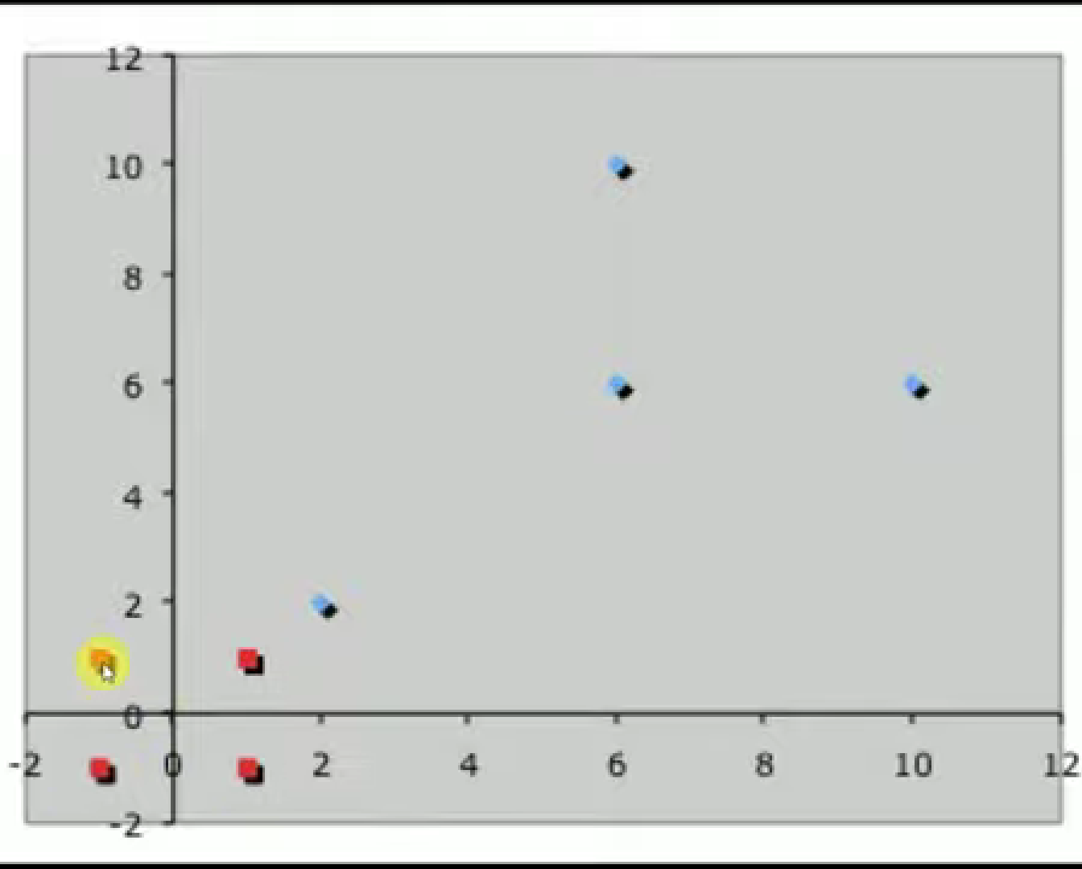
Original cluster (non-linear)
New cluster (linear)
Proceed to solve using linear cluster method)

Slide 11
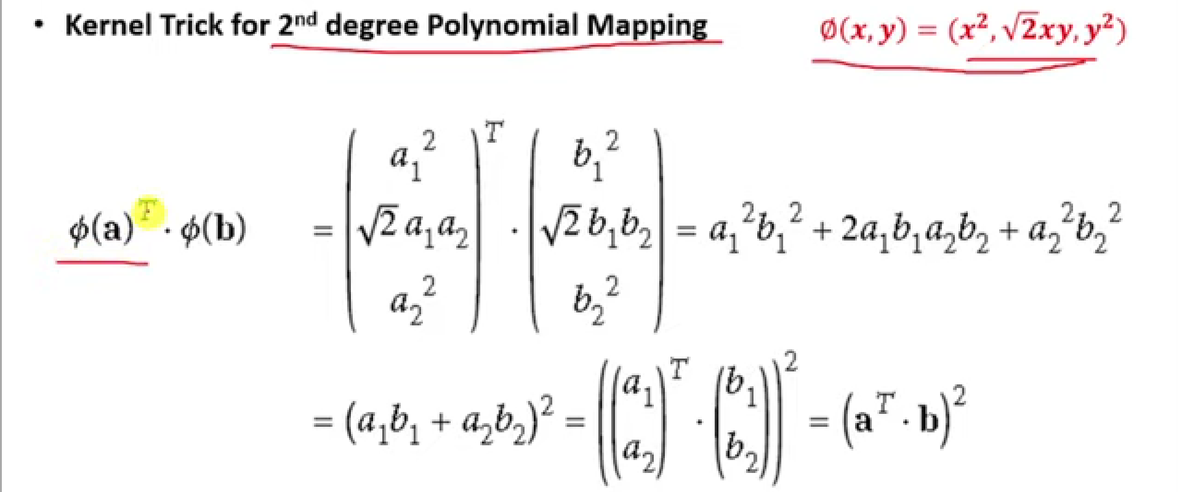
Kernel Trick
In case of non-linear data, introduction of new dimensions leads to overhead ( calculations become more complex)
Kernel function accepts inputs in the original lower dimensional space and returns the dot product of the transformed vectors in the higher dimensional space using mapping (no conversion involved)
Basically it allows us to compute the value without explicitly transforming the data.

Slide 12
